Slide 1

INTERNSHIP ON ETHICAL HACKING
NAME:-KHUSHBOO KUMARI
E-mail Id:-khushboo831015@gmail.com
This Photo by Unknown Author is licensed under CC BY-NC

Slide 2
CONTENTS:-
TASK1
TASK2
TASK3
In this task is there are several XSS labs on this website https://portswigger.net/web-security/all-labs. You can just choose any 5 of them and solve it
In this task you are completely free. http://testasp.vulnweb.com/ - This is the website. Explore the website and try to find vulnerabilities in the website and report it to us
Make a PPT of ur report

Slide 3
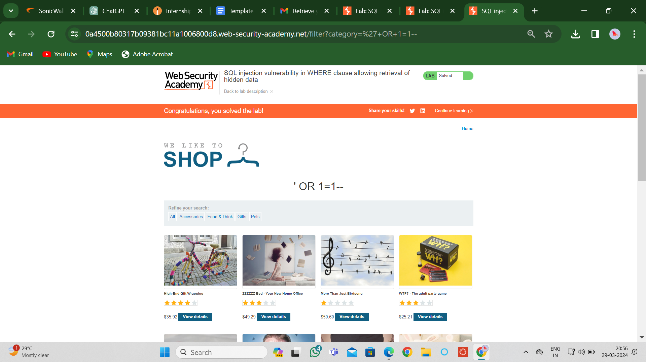
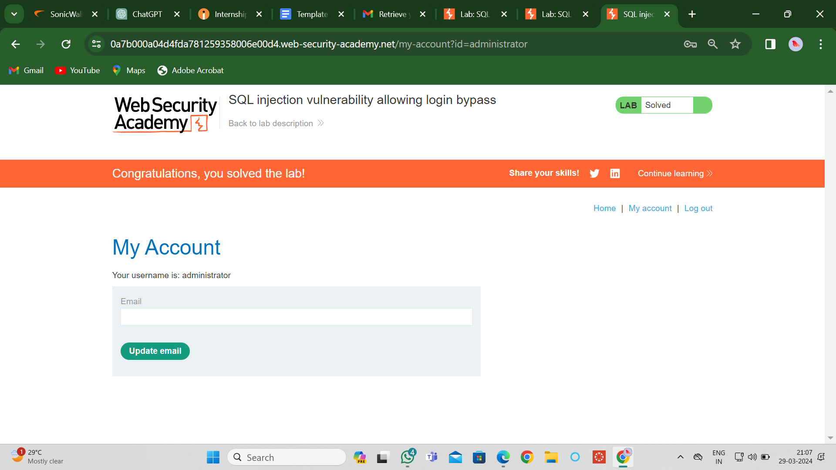
TASK1:Screenshots of XAAS Lab

Slide 4
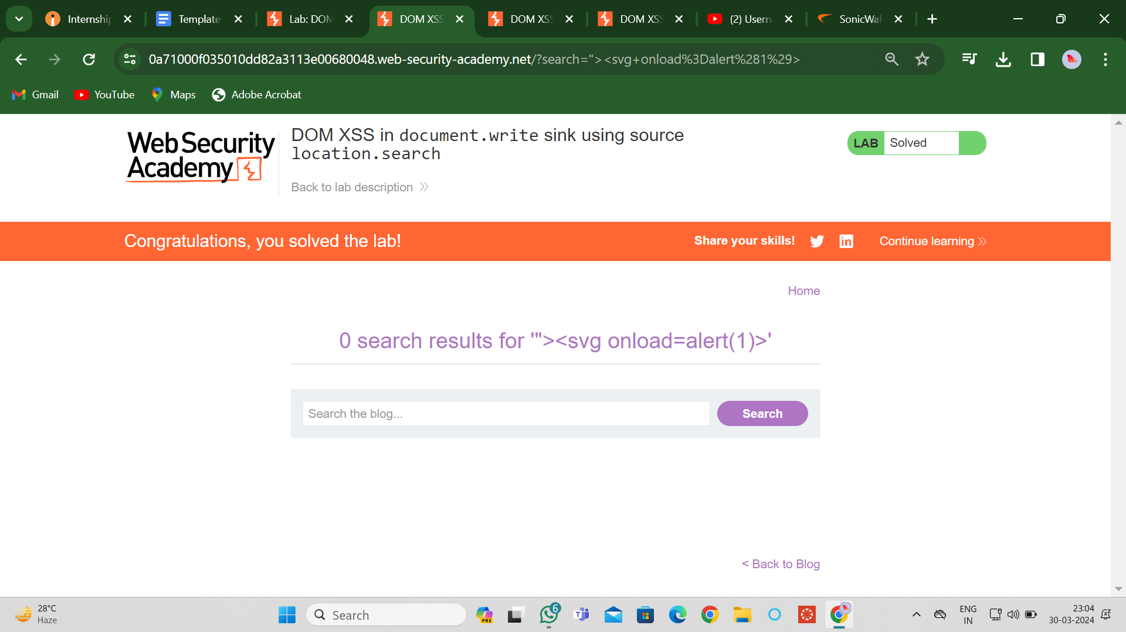
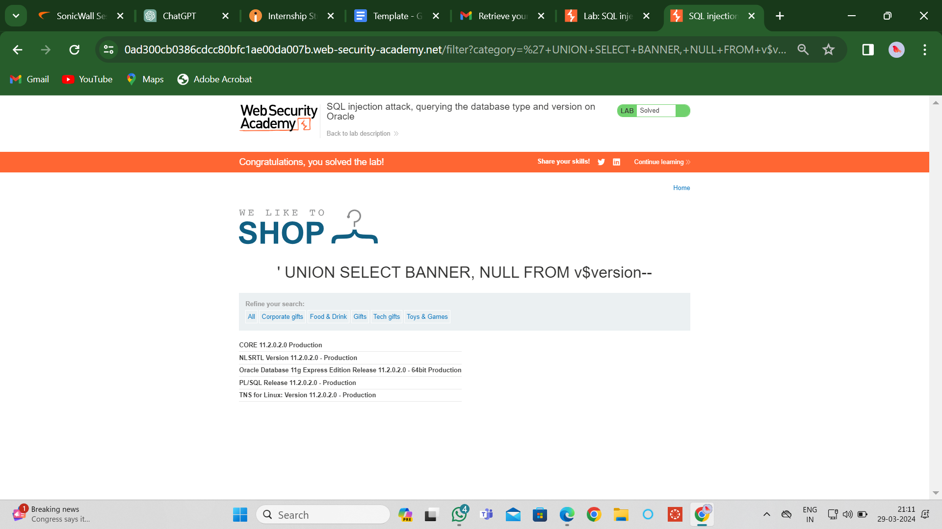
TASK1:Screenshots of XAAS Lab

Slide 5
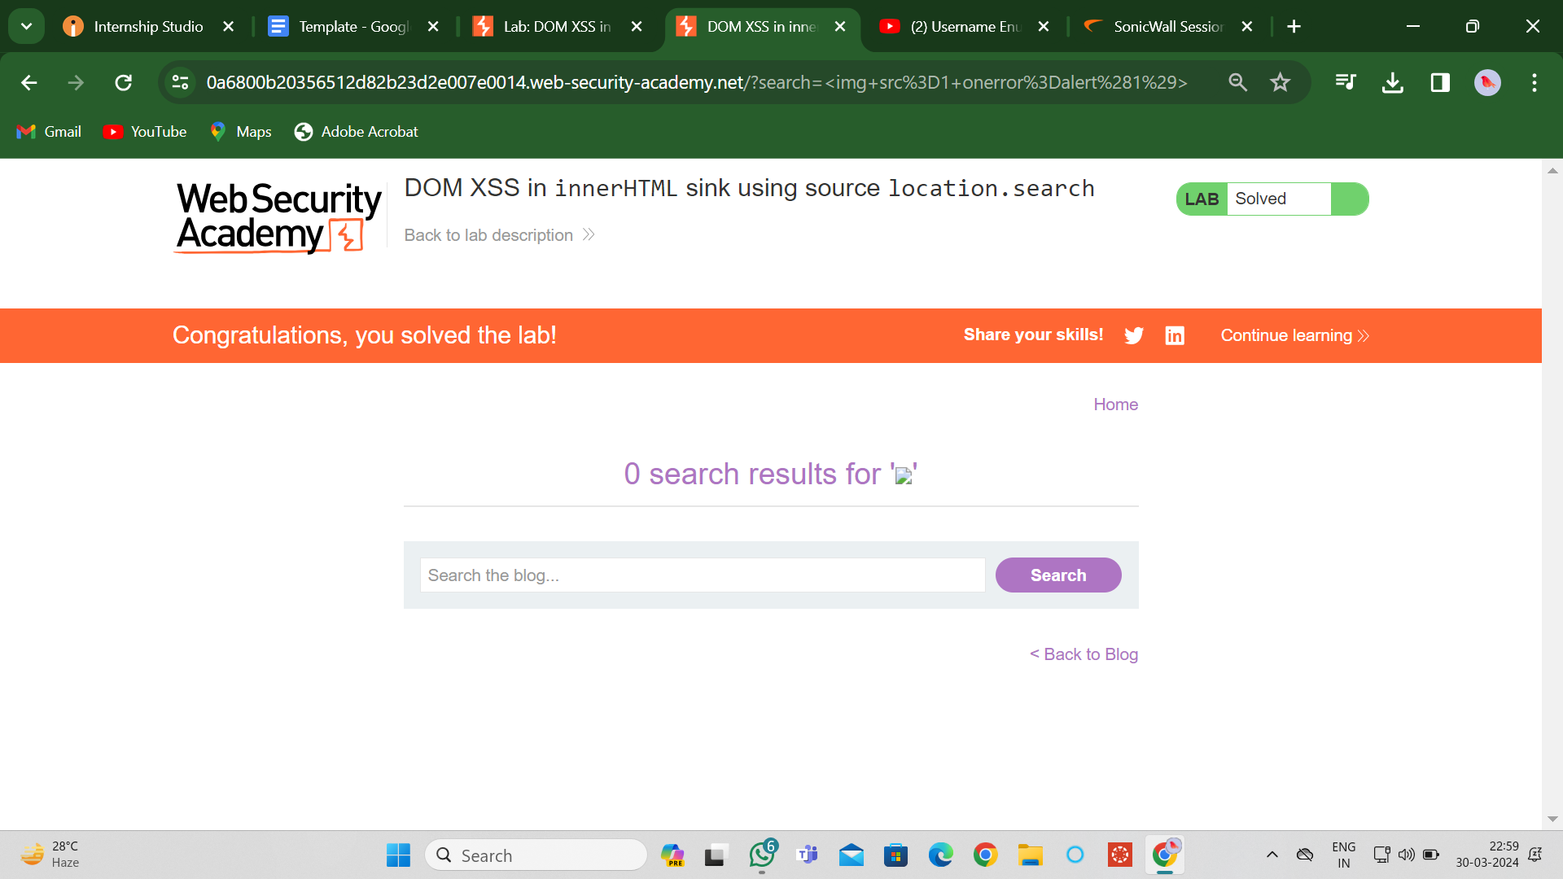
TASK1:Screenshots of XAAS Lab

Slide 6
TASK2:Check For Vulnerability
Target Application: http://zero.webappsecurity.com
Domain: Vulnweb.com
Subdomain: testasp.vulnweb.com
Scan Summary:
Overall Risk Level: Medium
Start Time: 20:24:31 (GMT+5:30)
Finish Time: 20:24:48 (GMT+5:30)
Scan Duration: 17 seconds
Tests Performed: 18/18

Slide 7
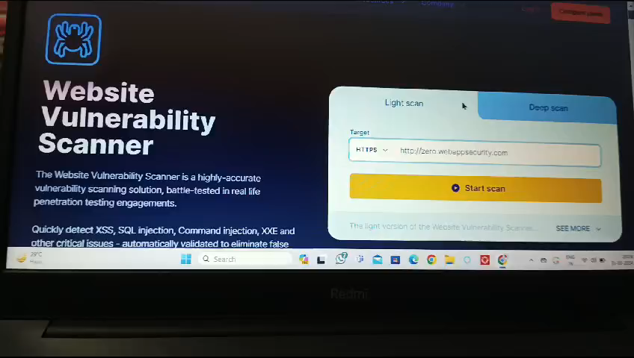
VIDEO

Slide 8
TASK2:Check For Vulnerability
Findings:
Vulnerabilities Found for Server-Side Software
Communication is Not Secure
Missing Security Headers
Security.txt File is Missing
Main Vulnerability:
The primary vulnerability identified in the target application is related to the usage of an outdated version of the jQuery library (version 1.8.2). Several Common Vulnerabilities and Exposures (CVEs) have been associated with this version, including CVE-2012-6708, CVE-2020-11022, CVE-2020-11023, CVE-2019-11358, and CVE-2015-9251. These vulnerabilities expose the application to Cross-Site Scripting (XSS) attacks, allowing attackers to inject and execute malicious scripts within the application context.

Slide 9
TASK2:Check For Vulnerability
Recommendations:
Update jQuery Library: Upgrade the jQuery library to the latest version (preferably version 3.5.0 or later) to mitigate the risk of XSS attacks associated with the identified CVEs.
Implement HTTPS: Configure the web server to use HTTPS to encrypt communication between the web browser and the server, reducing the risk of data interception and tampering.
Add Security Headers: Configure the server to include essential security headers such as Content-Security-Policy, Referrer-Policy, and X-Content-Type-Options to mitigate various attack vectors and enhance the overall security posture of the application.
Implement Security.txt File: Create and implement a security.txt file according to the standard guidelines, providing a designated channel for reporting vulnerabilities and security concerns.

Slide 10
TASK2:Check For Vulnerability
Target Application: http://zero.webappsecurity.com
Domain: Vulnweb.com
Subdomain: testasp.vulnweb.com
Scan Summary:
Overall Risk Level: Medium
Start Time: 20:24:31 (GMT+5:30)
Finish Time: 20:24:48 (GMT+5:30)
Scan Duration: 17 seconds
Tests Performed: 18/18

Slide 11
CONCLUSION
Addressing the identified vulnerabilities and implementing the recommended security measures is crucial to safeguarding the target application against potential security threats and ensuring the protection of user data and privacy. Regular security assessments and proactive measures are essential to maintaining a robust and secure web application environment

Slide 12


